Slide 1

Machine Learning Study Group
David Meyer
06.26.2015

Slide 2
Agenda
Agenda Bashing
Scalable Machine Learning course
Hanif
https://courses.edx.org/courses/BerkeleyX/CS190.1x/1T2015/info
Review of CTO Forum ML Discussion
dmm
What’s Next
Other?

Slide 3
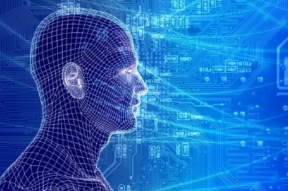
Machine Learning @ Brocade Where we are and where we are going
David Meyer
June CTO Forum
06.23.2015

Slide 4
Agenda
What is all the (ML) excitement about?
Review: What is ML (and why do we care)?
I want you to understand a bit about how this works
ML Projects Underway @ Brocade
Derick on “ML tools for DevOps”

Slide 5
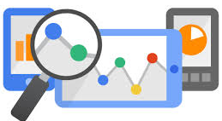
What is all the Excitement About?Context and Framing
Lots of excitement around “analytics” and machine learning
But what are “analytics”, and what use cases are
near term (vs longer term)?

Slide 6
One Way to Segment the Space
Historical Analytics
Build data warehouses / run batch queries to predict future events / generate trend reports
Near Real-Time Analytics
Analyze indexed data to provide visibility into current environment / provide usage reports
Real-Time Analytics (“streaming”)
Analyze data as it is created to provide instantaneous, actionable business intelligence to affect immediate change
Who’s network gear/software streams data?
Everyone will have to do this
Predictive Analytics
Build statistical models that can classify/predict the near future
BTW, how can this work from a technical perspective?
This is where we want to go

Slide 7
Another Way To Think About This
The Automation Continuum
Machine Learning
Average Enterprise
Industry Pioneers
CONTROLLER-BASED ARCHITECTURE
CLI
CLI SCRIPTING
Manual
Automated/Dynamic
CLI
AUTOMATION
Machine
Intelligence
INTEGRATION
PROGRAMMABILITY
DEVOPS / NETOPS
ORCHESTRATION
Original slide courtesy Mike Bushong and Joshua Soto
Notes:
Most customers are at the very early side of this continuum of maturity when it comes to automating the network. They may have a couple of expect scripts, some MOPs and SOPs, but things are not really automated in any really meaningful way. They don’t have any sort of control framework or controller, not using OpenStack, not interested in programmability. Most want the network to be easier to manage.
Companies such as Netflix, are at the furthest end of the spectrum using a much more fully integrated Dev/NetOps approach
Our job is not to paint a picture of our customer’s full operational maturity, our job is to show them that we know what full operational maturity looks like and then get them further down the continuum in that direction.
Present in the industry today is a huge separation between where customers are today and the “vision” that everyone is talking about.
Your role as a sales person, is to be the TRUSTED ADVISOR that doesn’t judge the customer for where they are, but can identify their current pain point and point to a path to full operational maturity over the next several years.
Mike’s analogy for a 22hr treadmill session

Slide 8
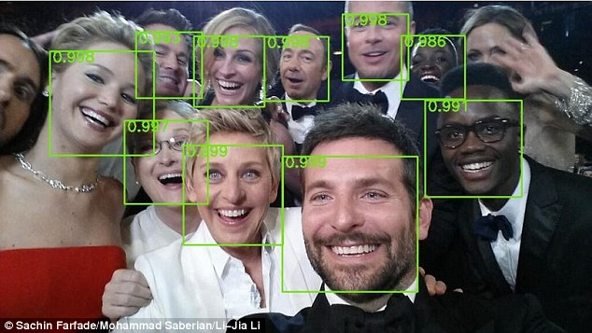
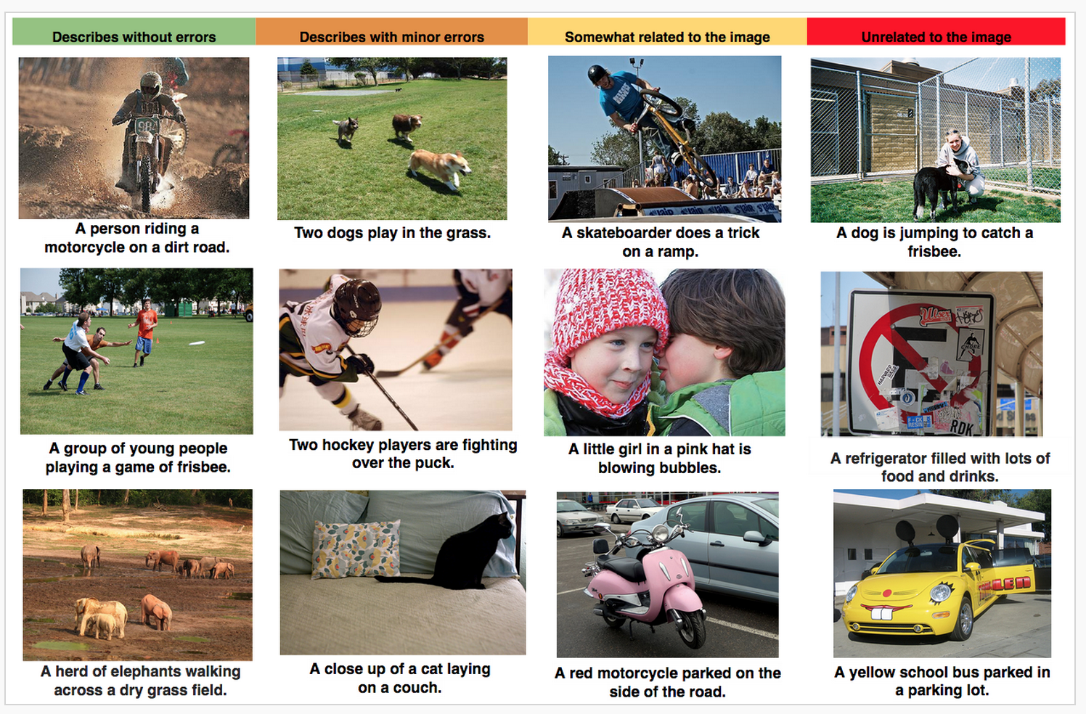
Ok, where is all the (ML) action?
Deep learning (what is that?) enjoying great success in an exploding number of use cases
“Perceptual” tasks reaching super-human performance
Network still lagging (but not for long)
Object Recognition
Auto-Captioning
Why this is relevant: Network use cases will use the same technology (more later)

Slide 9
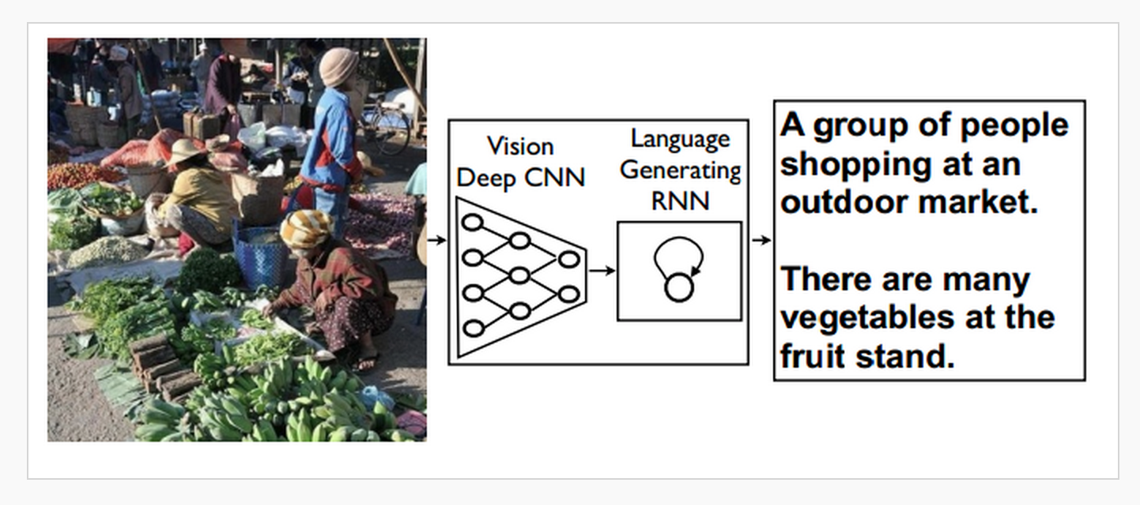
Auto-Captioning Cartoon How it Works

Slide 10
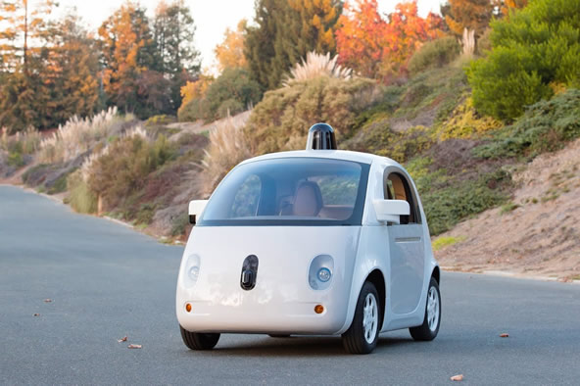

Self-Driving Cars

Slide 11
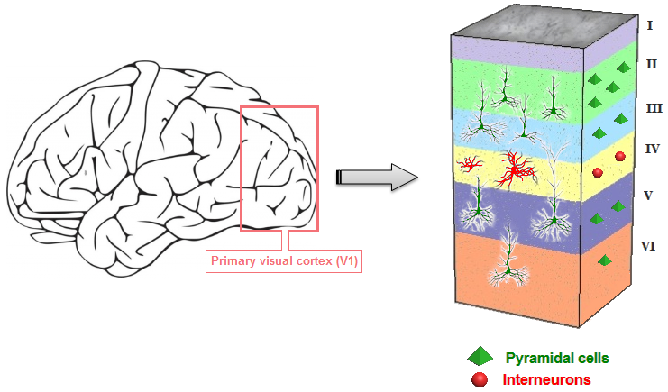
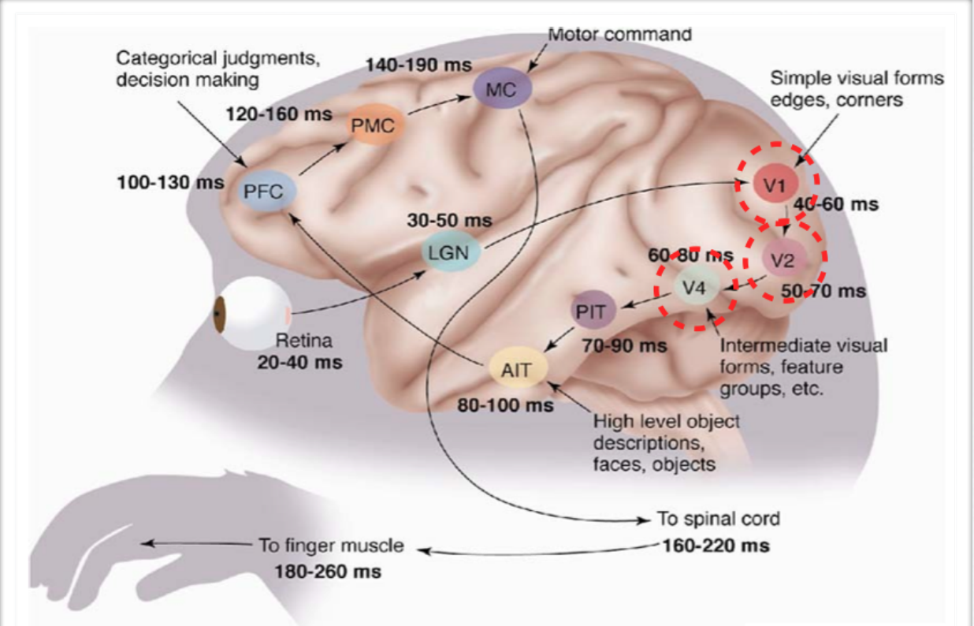
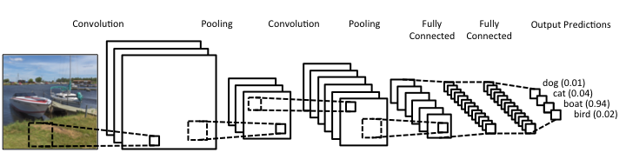
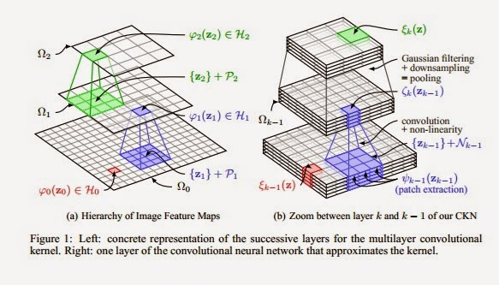
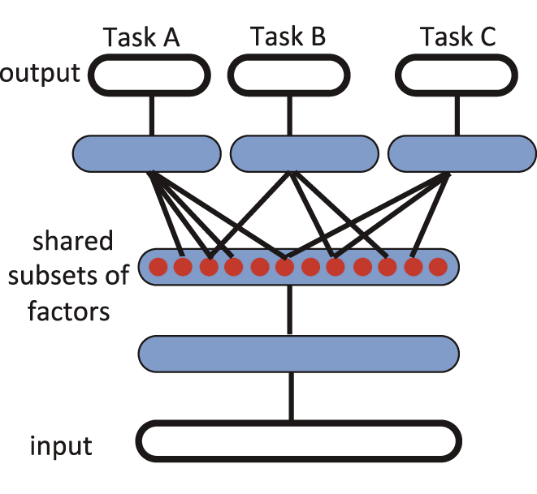
How Does Your Car Actually See?
How your brain sees
How your car (camera, …) sees
Convolutional Neural Nets (CNNs)
In Cartoon Form
Courtesy Simon Thorpe
See http://www.wired.com/2015/05/wolframs-image-rec-site-reflects-enormous-shift-ai/

Slide 12
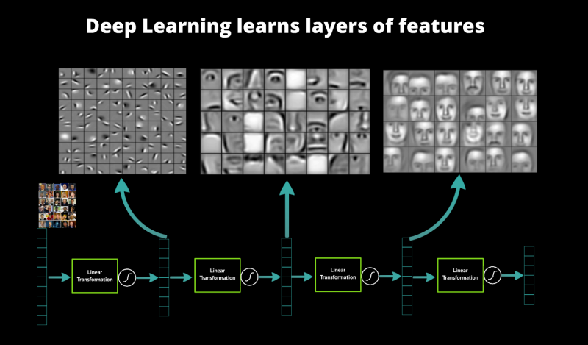
Another View
Key takeaway: Features compose in distributed representations

Slide 13
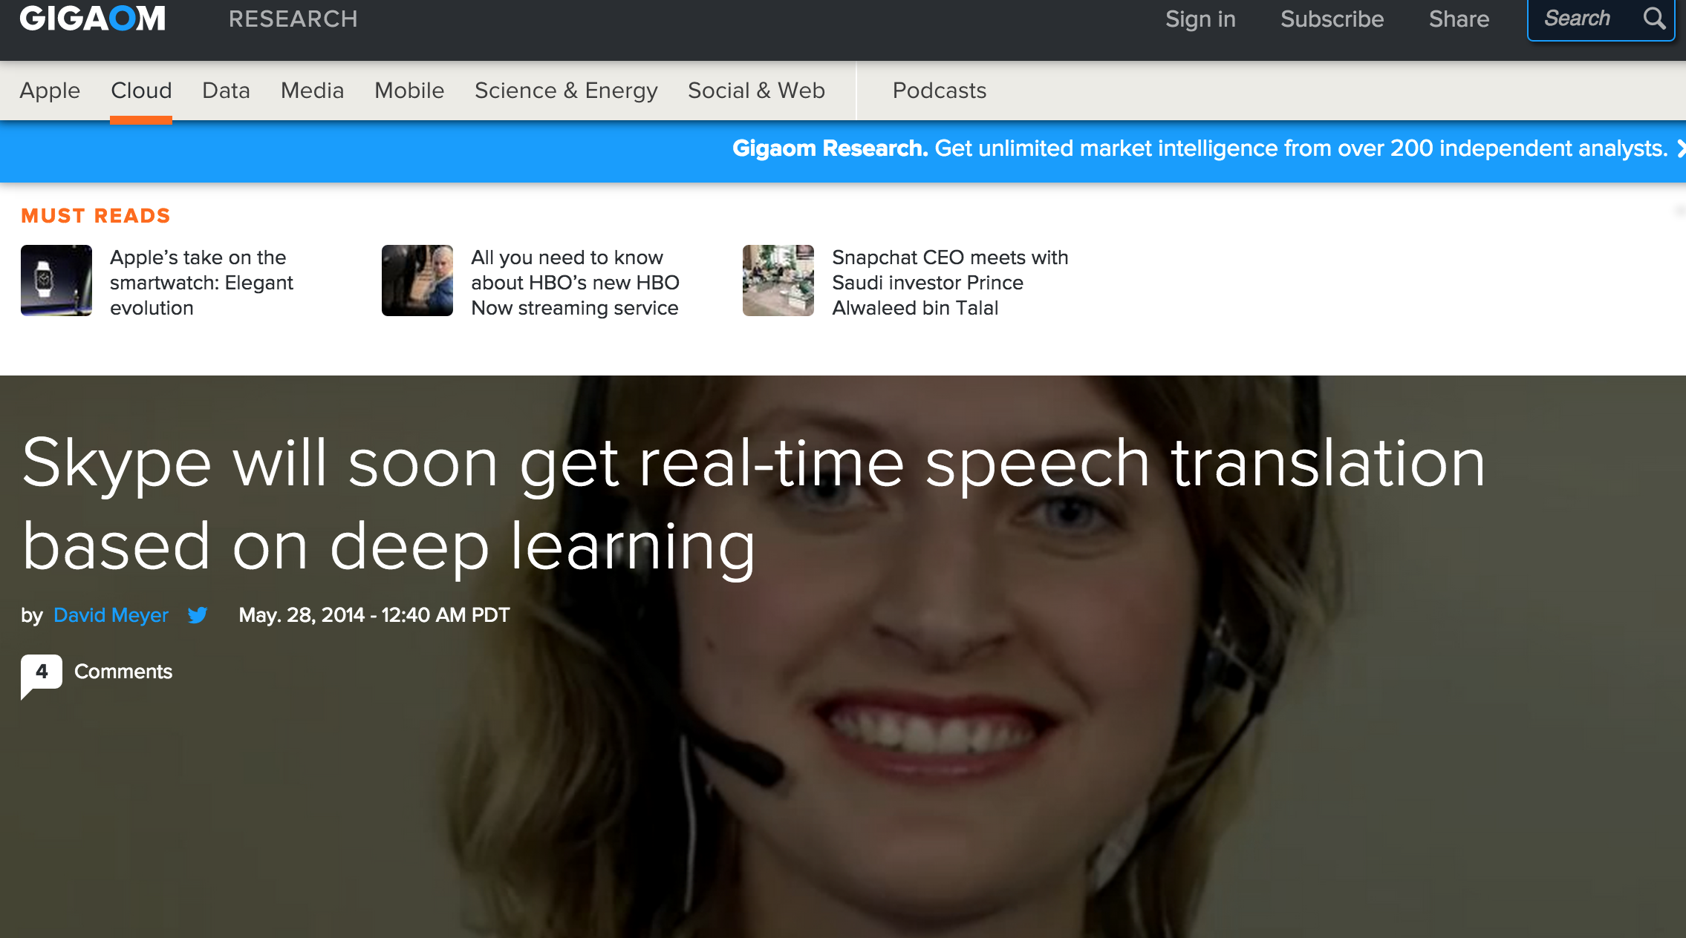
But that’s not all

Slide 14
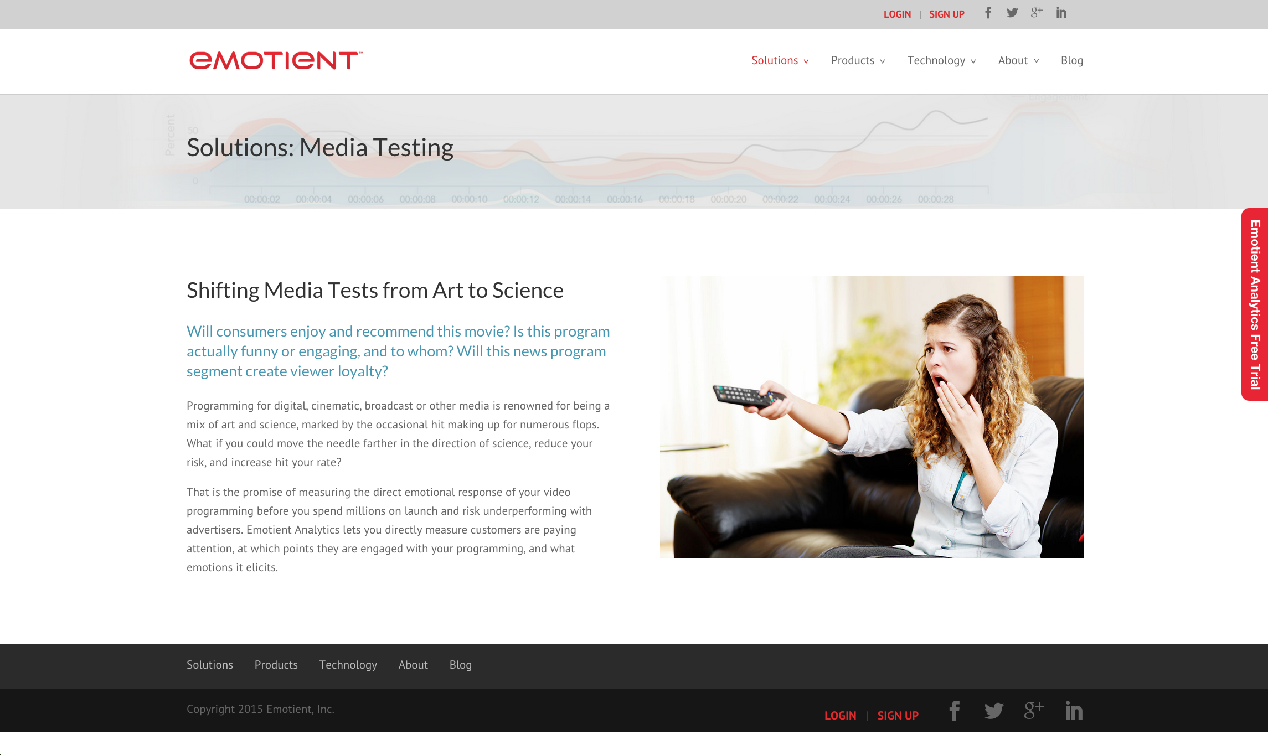
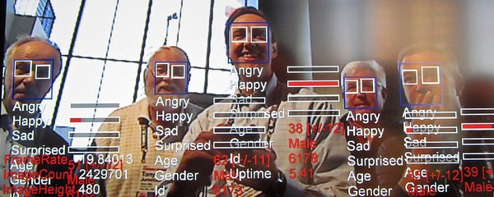
Think Speech/Object Recognition is Impressive?

Slide 15
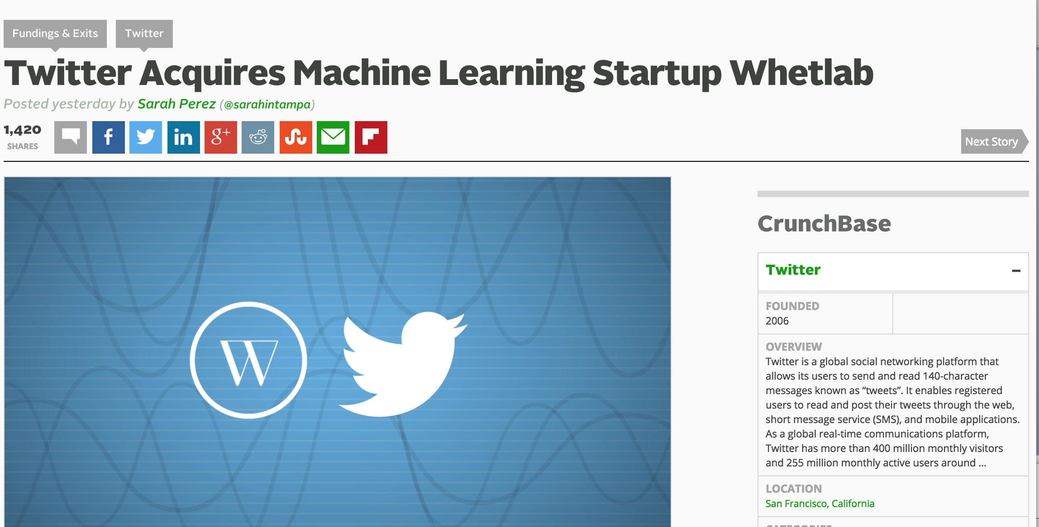
Everyone is in this game (M&A Gone Wild)

Slide 16
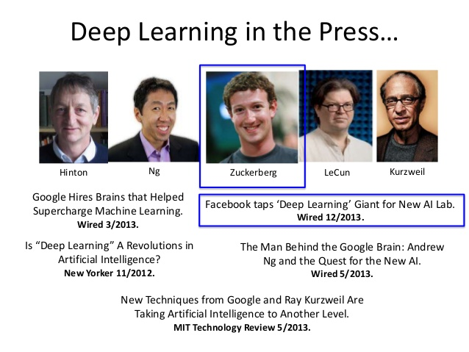

Slide 17

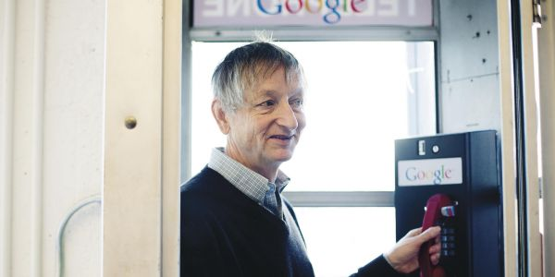



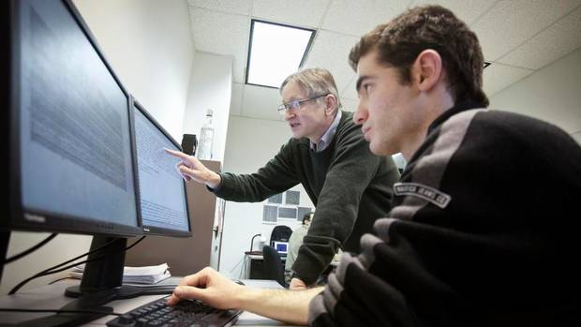
Main Characters (my take)
http://chronicle.com/article/The-Believers/190147

Slide 18
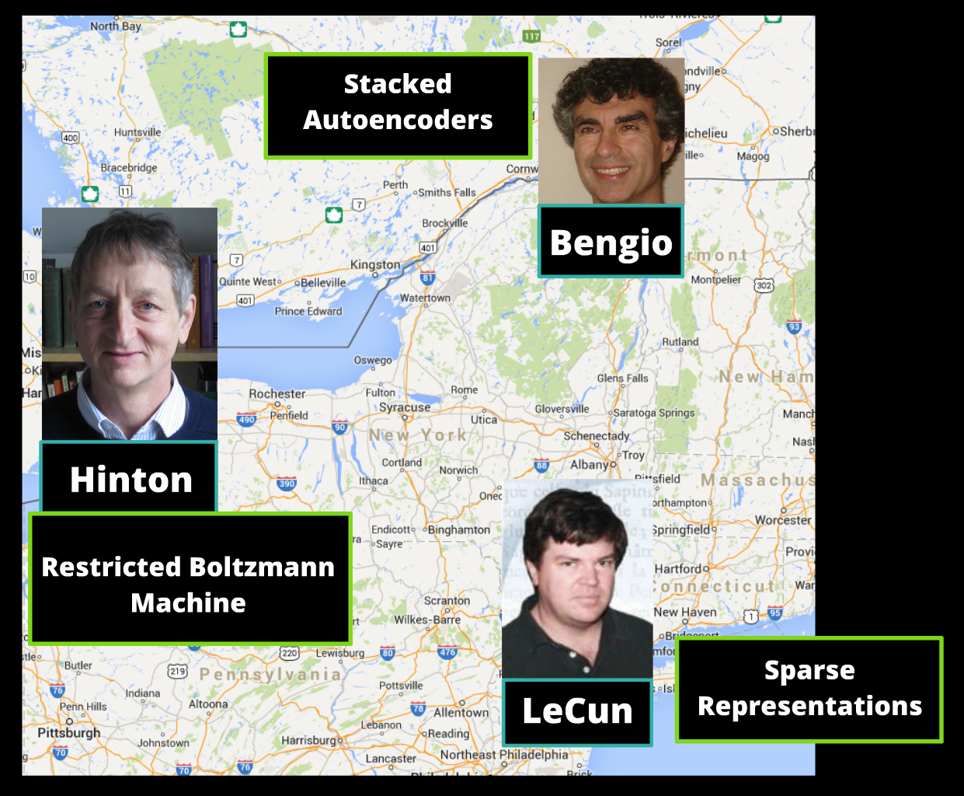
Geography

Slide 19
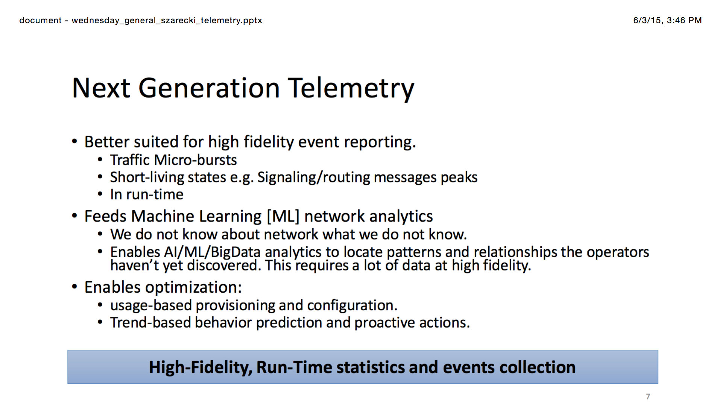
Ok, But How About Networking? Well, The ML Cat is Out of the Bag (NANOG 64)
The network community doesn’t
know how to do this (yet)
See https://www.nanog.org/sites/default/files//meetings/NANOG64/1023/20150603_Szarecki_Architecture_For_Fine-Grain__v2.pdf

Slide 20
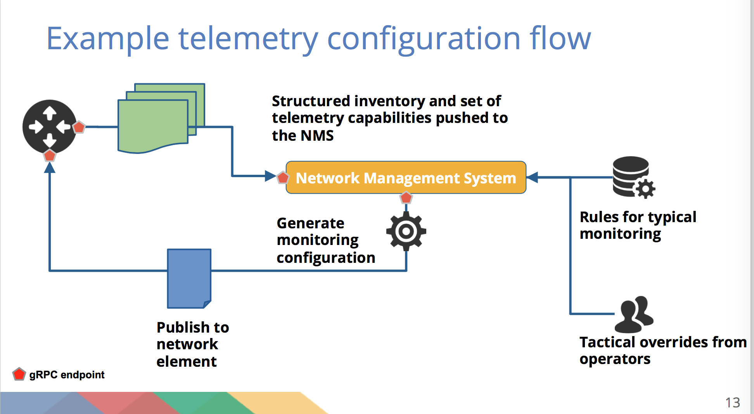
COOB, redux (NANOG 64)
See https://www.nanog.org/sites/default/files//meetings/NANOG64/1011/20150604_George_Sdn_In_The_v1.pdf

Slide 21
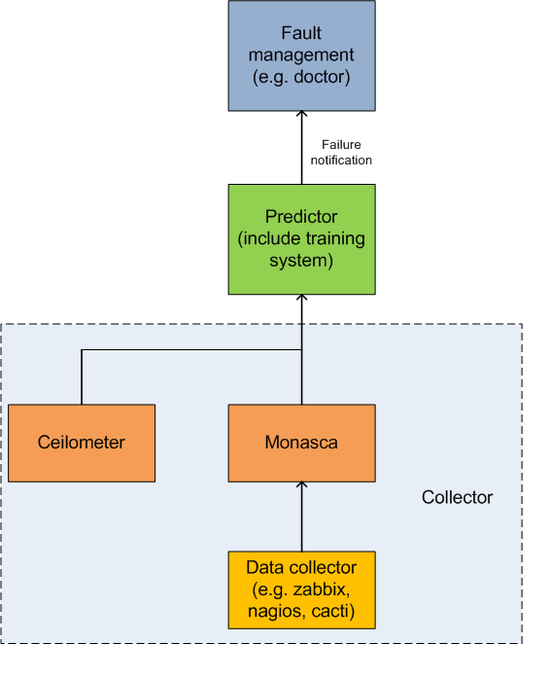
OPNFV Predictor
See https://wiki.opnfv.org/requirements_projects/data_collection_of_failure_prediction

Slide 22
Brocade Off-Box Strategy Network Automation Apps - Phasing
Integrated Operational App suite
Policy, Build Overlay & Underlay, Visibility, Flow Optimization
Scale out / HA management plane support - ODL
Nominal $ value + Support
Differentiated
“Open” multivendor support for standard protocols
Network Services Application Suite
Machine Learning Apps.
ODL / BVC Use case Support
Python Libraries - pynos
Initial Toolsets & basic Apps
Open Sourced
Phase 1
Phase 2
Phase 3
Slide courtesy Ken Ross

Slide 23
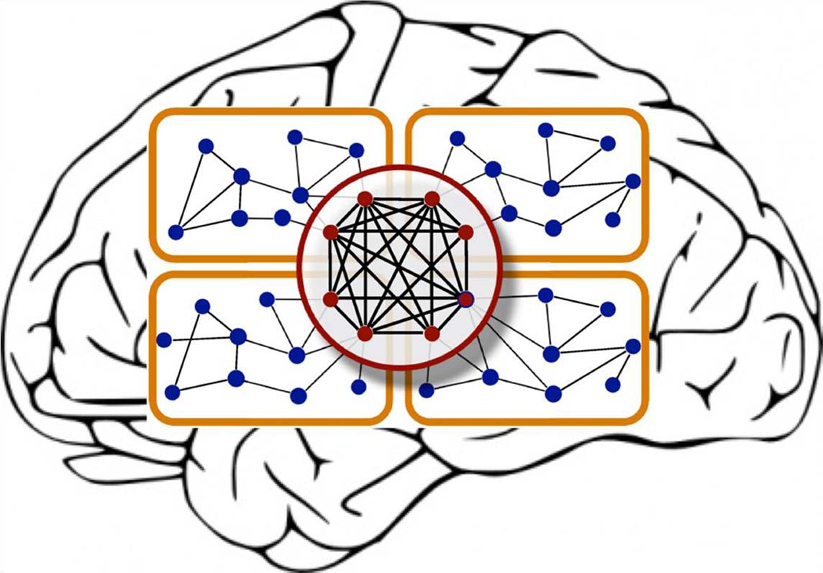
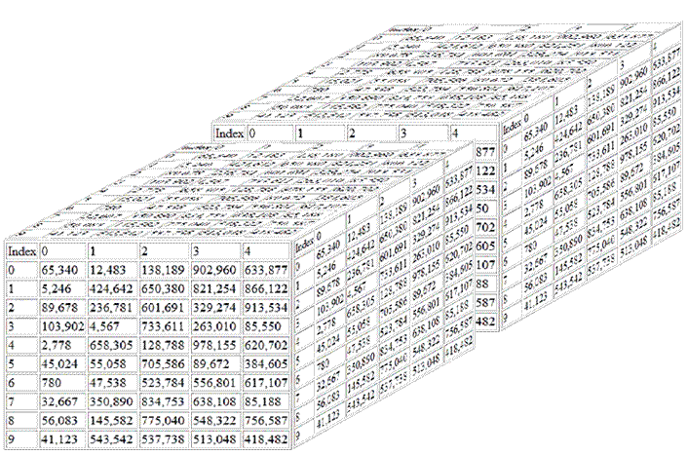
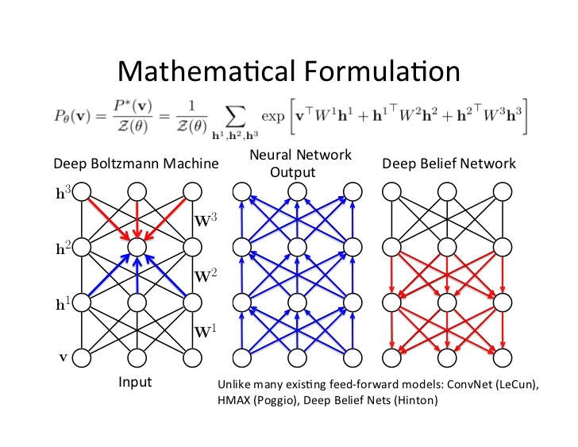
OK, Now Imagine This…
First, envision the network as a huge sensor network
Each counter (etc) is a sensor
Each sensor is a dimension
This forms a massive high-dimensional real-valued vector space
Note: Curse of dimensionality (more later if we have time)
Guess what: This data is ideal for analysis/learning with deep neural networks
Contrast “simple” ML algorithms
Now imagine this kind of capability:
Interface ge 0/0/1 on gw-foo1 just flapped. This is going to cause
cpu utilization on gw-foo2 to spike and cause you to blackhole traffic to
A.B.C.D/16 with probability .85. The probability distribution is
visualized at http://….
Well guess what (again): With the right data sets we can build this (and a lot more)

Slide 24
Agenda
What is all the (ML) excitement about?
Review: What is ML (and why do we care)?
ML Projects Underway @Brocade
Derick on “ML tools for DevOps”

Slide 25
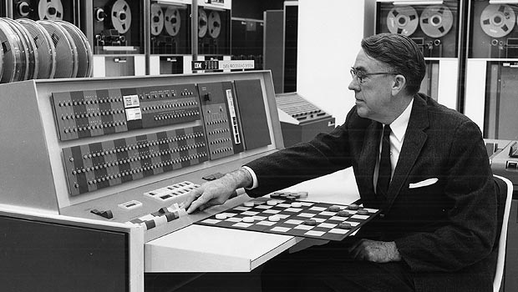
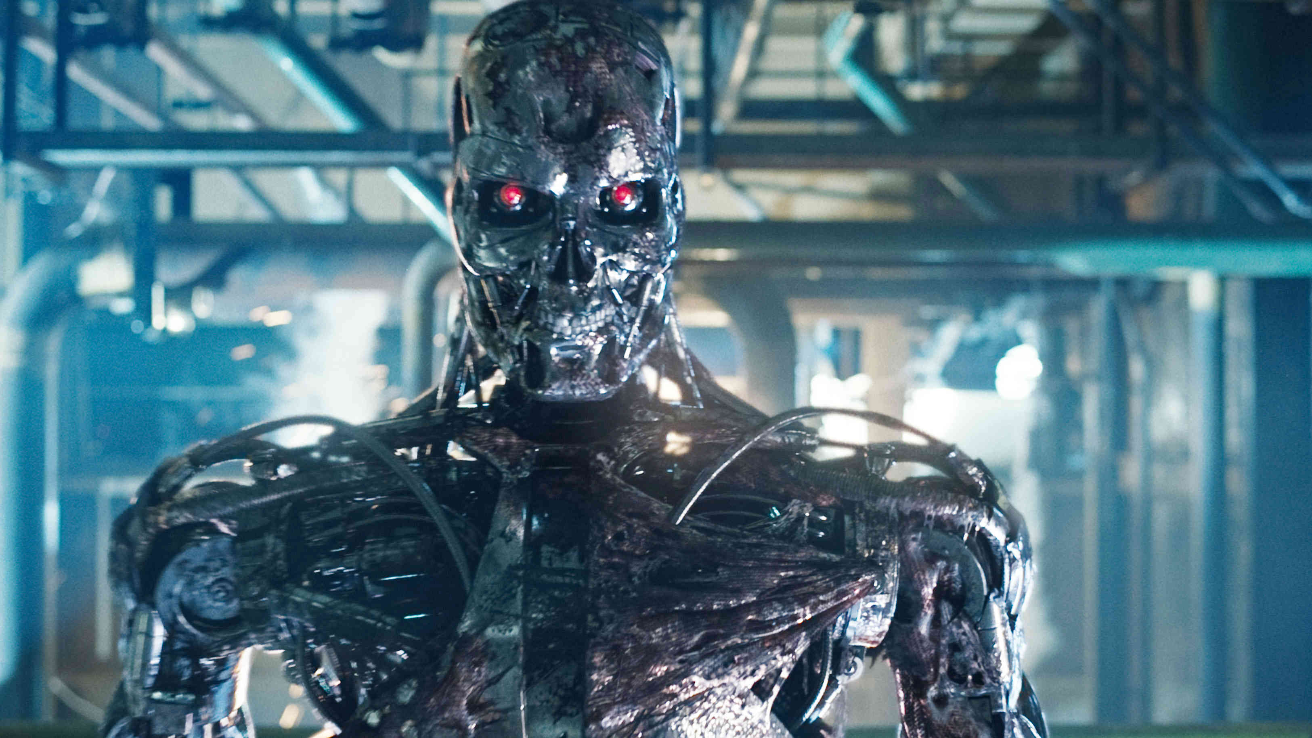
Well That’s All Cool, But What is ML?

Slide 26
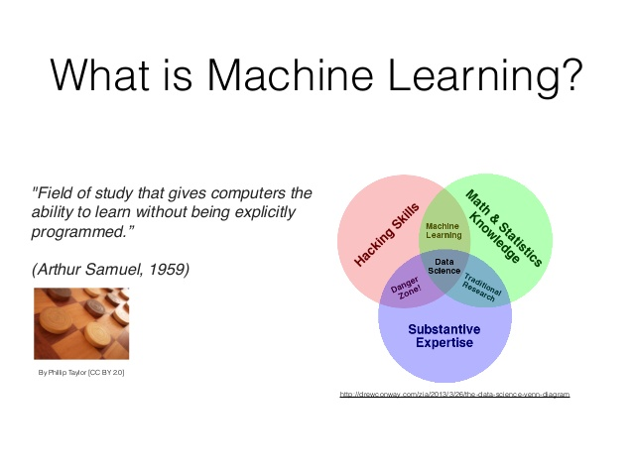

Slide 27
What is Machine Learning?
The complexity in traditional computer programming is in the code (programs that people write). In machine learning, algorithms (programs) are in principle simple and the complexity (structure) is in the data. Is there a way that we can automatically learn that structure? That is what is at the heart of machine learning.
-- Andrew Ng
That is, machine learning is the about the construction and study
of systems that can learn from data. This is very different than
traditional computer programming.

Slide 28
The Same Thing Said in Cartoon Form
Traditional Programming
Machine Learning
Data
Computer
Output
Program
Data
Computer
Program
Output

Slide 29
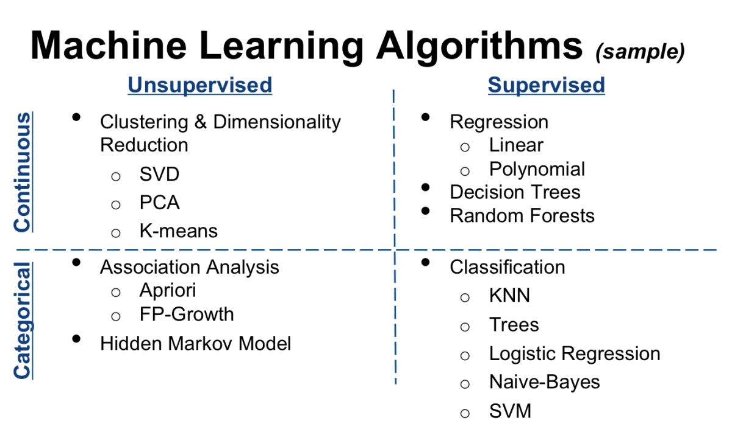
BTW, there are 2^10s of ML Algorithms
Thanks Varma!
Spark Mllib
R arules
Note that data are very similar to KDD CUP 1999
dataset: http://kdd.ics.uci.edu/databases/kddcup99/kddcup99.html

Slide 30
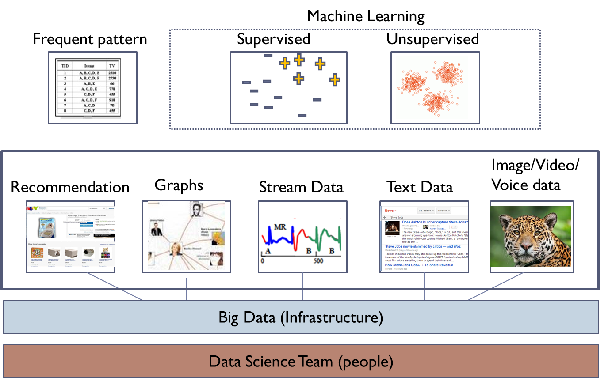
ML “Stack”

Slide 31



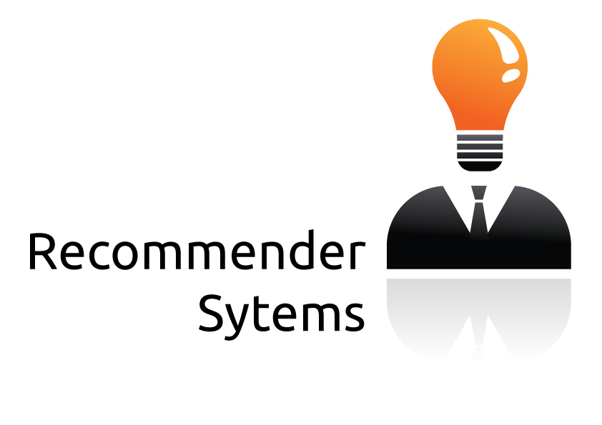



Pipeline/Workflow View
Domain Knowledge
Domain Knowledge
Domain Knowledge
Domain Knowledge
3rd party Applications
Analytics Platform
Learning
Presentation Layer
Intelligence
Data Collection
Packet brokers, flow data, …
Preprocessing
Big Data, Hadoop, Data Science, …
Model Generation
Machine Learning
Oracle
Model(s)
Remediation/Optimization/…
Oracle
Logic
Topology, Anomaly Detection,
Root Cause Analysis,
Predictive Insight, ….

Slide 32
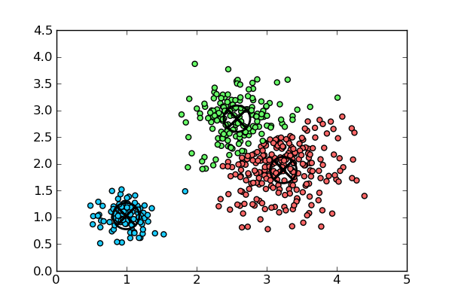
BTW, what would it take to run KMeans on Varma’s data (Spark/Mllib/Scala)?
val kmeans = new KMeans()
kmeans.setK(K)
kmeans.setRuns(runs)
kmeans.setEpsilon(epsilon)
val model = kmeans.run(normalizedData)
val clusterAndLabel = rdataAndLabel.map {
case (normalizedData,label) => (model.predict(normalizedData), label)}
val clusterLabelCount = clusterAndLabel.countByValue
clusterLabelCount.toList.sorted.foreach {
case ((cluster,label), count) => println(f"$cluster%1s$label%18s$count%8s")}
Complete code: http://www.1-4-5.net/~dmm/code/ml/pca+km.scala
More code: https://github.com/davidmeyer/ml

Slide 33
Agenda
What is all the (ML) excitement about?
Review: What is ML (and why do we care)?
ML Projects Underway @ Brocade
Derick on “ML tools for DevOps”

Slide 34
Active ML Projects @ Brocade
INFusion Labs
Varun (dmm standing in)
Anomaly Detection using Multivariate Guassian distribution(s)
Learn p(X;μ,Σ) ~ N(μ,Σ)
Declare X an anomaly if p(X) < ε
ML Tools for DevOps
Derick
KMeans, FP Growth, others
Sync with Bushong’s off-box/data collection strategies
Converged Infrastructure & Machine Learning/Control Plane AD
PG
Data Management/Anomaly detection
Varma
Connectem
Nishi/Sachin
Lots of ideas for controller applications (e.g., PCE)
Others (Vistapointe, Brass, manufacturing)?

Slide 35
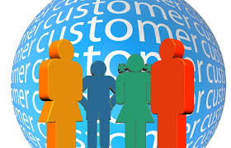
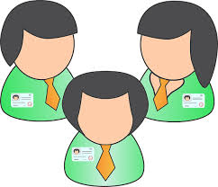
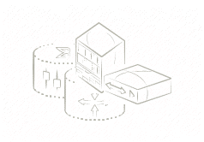
INFusion Labs Round 1 Projects
Google gRPC
+ open config
(4 SJ + 1 BLr)
machine Learning Infrastructure
(3 SJ + 2 Blr)
INFusion
Labs
EXTENSIVE python apI
(4 SJ + 2 Blr )
Slide courtesy Varun Satrawla

Slide 36
Anomaly Detection Project Framework
NOS VM
3rd party VM
Create data-sets of state for processes
Python client streams new samples to sever
Apply AD (multivariate ND) to detect abnormalities and takes action
Update datasets
Repeat
NOS processes
Datasets
L3 Mgr
HSLUA
L2SYS
:
:
Normal
CPU usage
Memory usage
Critical errors
Protocol state
Low abnormal
Anomaly
Detection
Anomaly
Detection
Med abnormal
Multivariate Gaussian
High abnormal
Python Based
Client
Python Based
server
Socket interface
Linux Host (kvm)
Slide courtesy Varun Satrawla

Slide 37
On to Derick
Thanks!

Slide 38
Backup

Slide 39
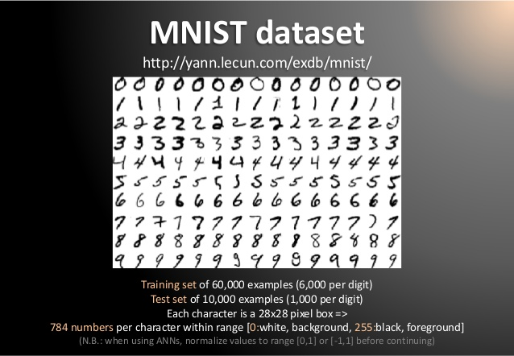
Dimensionality
Machine Learning is good at understanding the structure of high dimensional spaces
Humans aren’t ☹
What is a dimension?
Informally…
A direction in the input vector
Example: MNIST dataset
Mixed NIST dataset
Large database of handwritten digits, 0-9
28x28 images
784 dimensional input data (in pixel space)
Consider 4K TV → 4096x2160 = 8,847,360 dimensional pixel space

Slide 40
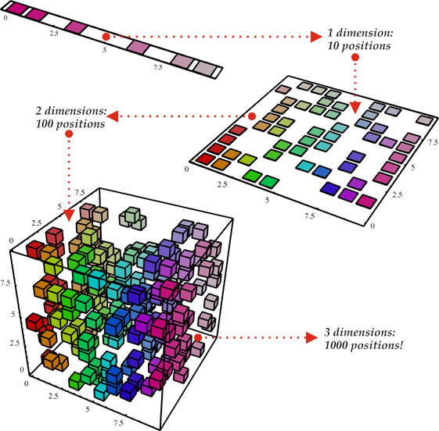
Why ML Is Hard The Curse Of Dimensionality
To generalize locally, you need representative examples from all relevant variations
There are an exponential number of variations
So local representations might not (don’t) scale
Classical Solution: Hope for a smooth enough target function, or make it smooth by handcrafting good features or kernels
Distributed Representations
Unsupervised Learning
(i). Space grows exponentially
(ii). Space is stretched, points
become equidistant

Slide 41
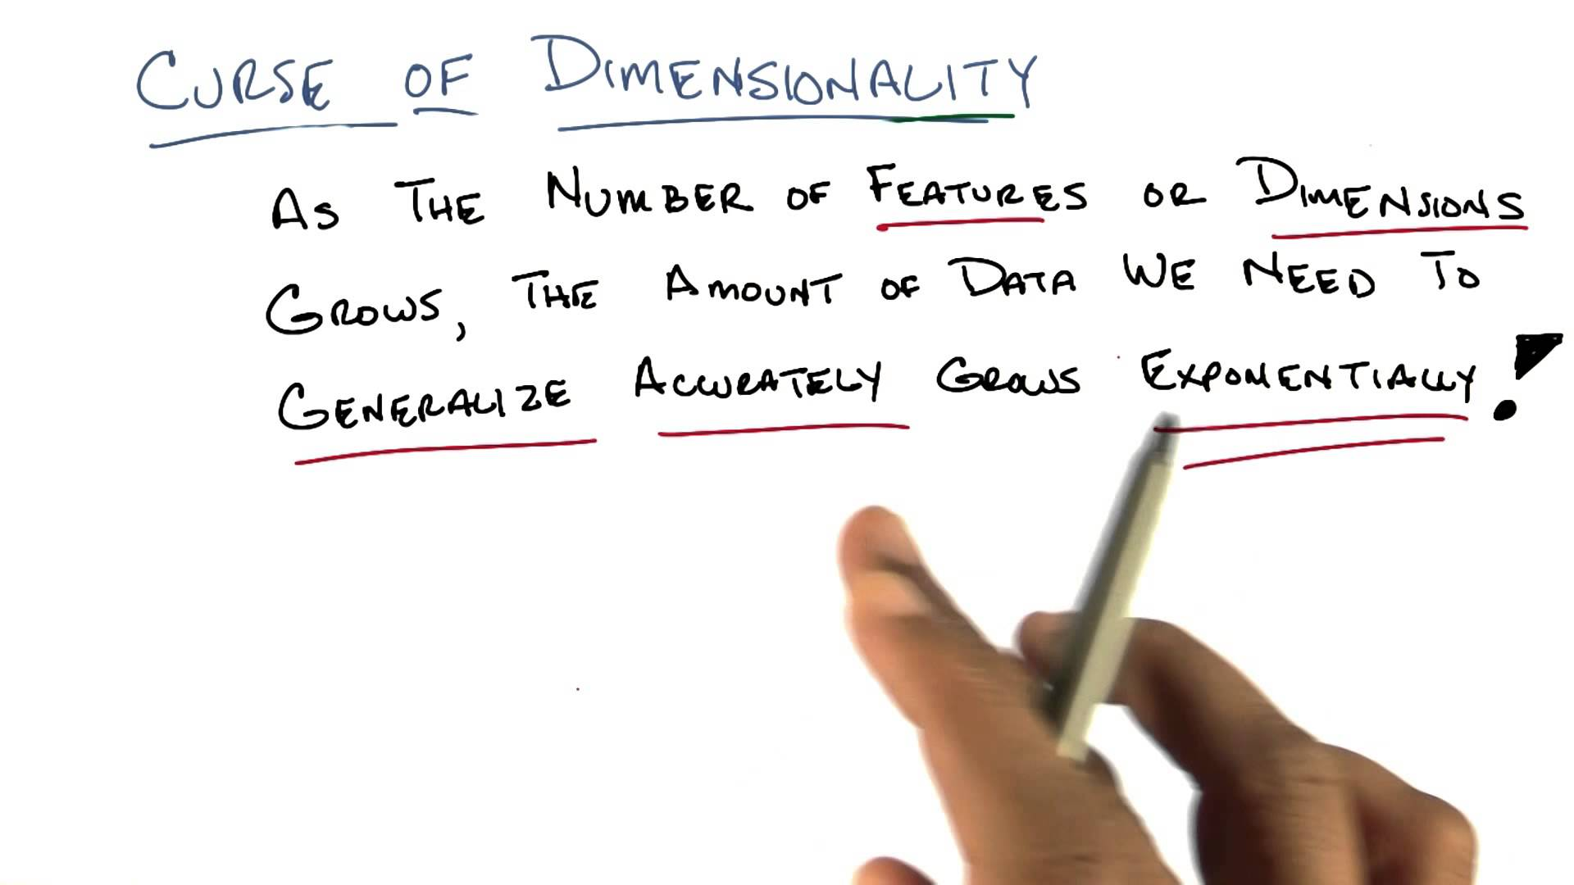
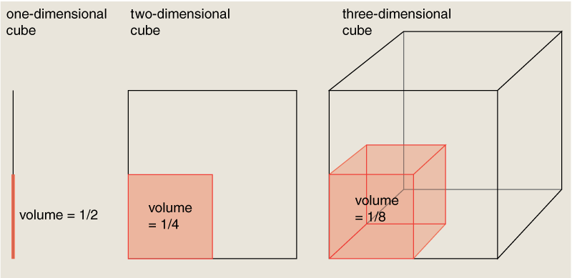
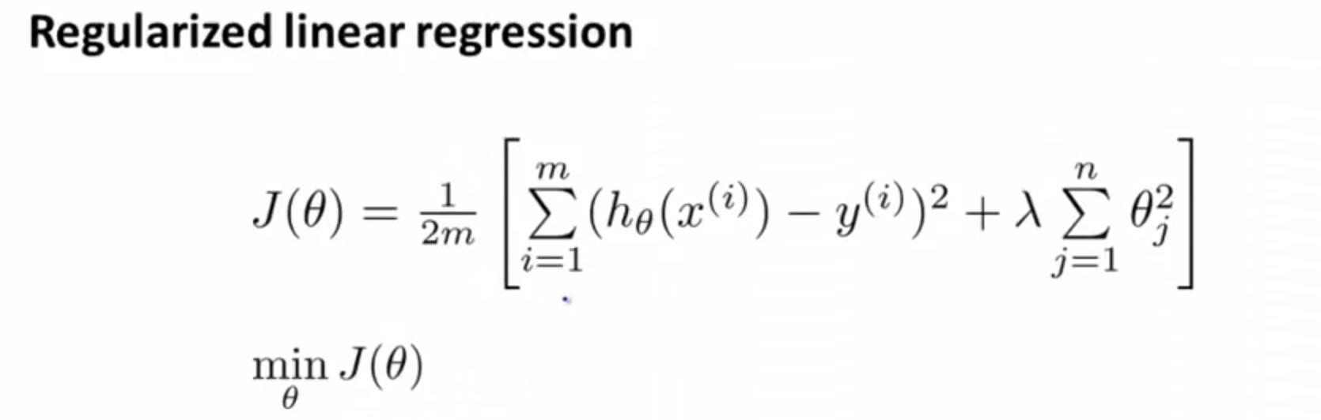
Curse of Dimensionality Redux
“distance”

Slide 42
What’s Next
Possible Topics
Scalable Machine Learning course
Hanif
https://courses.edx.org/courses/BerkeleyX/CS190.1x/1T2015/info
Andrew Ng’s Coursea Course
Vish, others
Anyone taking Daphne Koller’s course?
Large Scale Data Acquisition
Varma
Mobile Use Case(s)
Tim
Dave/Derick/Nishi (Connectem)
Varun update
PG?
Others?
Schedule
07.10: Cancel (I’ll be at ICML). We can reschedule if we can find a time.
07.24: Open
08.07: Open

